Slide 1
Arduino Learning Kit
Austin Motz - Eagle Project

Slide 2
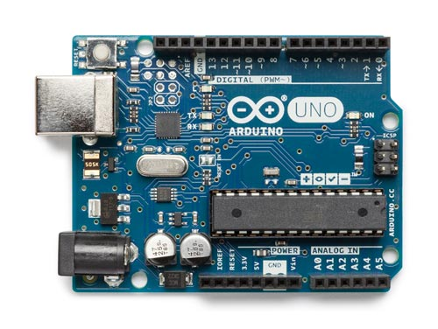
My Project
10 classroom projects
Ranges from LEDs to a robot
Teaches:
C programming
Breadboarding
Circuitry
Problem Solving

Slide 3
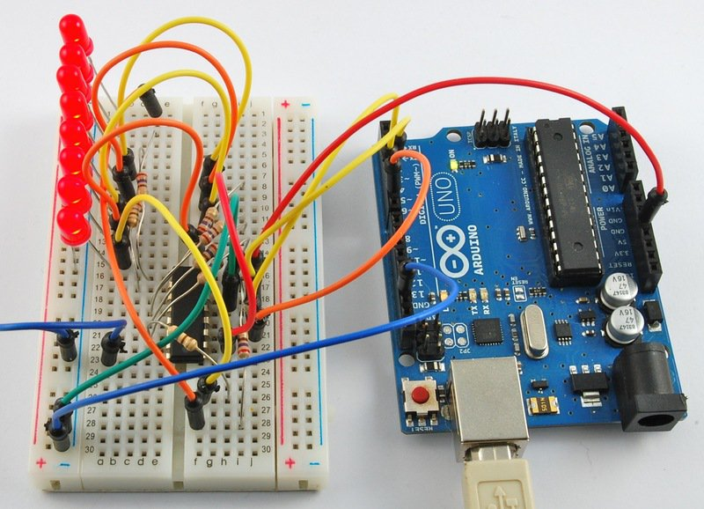
Arduinos
Small microcontrollers
Plug into the computer and program them
Controls just about anything
Very cheap
Easy to use

Slide 4
Need
Tried to use Arduinos when I was in Middle School
Lack of knowledge led to nothing being learned
Brings the materials that are currently going unused a purpose
Arduinos already owned by Nagel
Arduino Learning Kit
New Learning Experience

Slide 5
Project Design
Provided Instruction
Student(s)
Program & Breadboard
Syntax
Circuit
Arduino
Output
Sensor

Slide 6
Leadership Opportunities
Organizing many groups of people
Creators of the Circuit design
Programmers
Testers
Beneficiary
Consultants for any additional help
Gather from my robotics community, my father’s work, friends, and scouts in middle school
Must organize the groups without them all being together at once

Slide 7
Materials, Supplies, and Tools
Materials
Breadboards
Resistors
Photo Resistors
Servos
1/8" Pine Wood Sheet
Potentiometers
Wires
Motors
Text Display
Touch Sensor
USB Cord
Tools
Laser Cutter – At a maker space I belong to
3D Printer – Also at the maker space
Computers
Supplies
Electrical Tape
Paper
Replacement Parts

Slide 8
Cost
$250 of materials per kit with 10 kits
Many materials will be supplied by me or already owned by the school
I will be able to use the maker space free
~$500 grant should be able to cover the rest
Raw
After Reductions
Materials: | $2,500
Supplies: | $40
Tools: | $300
Total: | $2,840,00
Materials: | $500
Supplies: | $40
Tools: | $0
Total: | $540

Slide 9
Phases
Pitch to Beneficiary
Design Circuit
Test with Scout from 281
Make Sample Code
Document all Problems
Solve Any Problems during Testing
Give Resources to Beneficiary
Gather Kit Materials

Slide 10
Extra
Permissions:
Make sure resources will be used (not part of project though)
Logistics
Testing will be done in an area with enough room for however many scouts are testing it
Safety
Small Shocks
First Aid Kit Available

